Slide 1


AI vs Human Tweets
Using TF-IDF + Logistic Regression
PRESENTED BY :
DHANANJAY K.N
MADAN R
GURUKIRAN J.S
RAKESH S
PRESENTED TO :
UMESH D.K
&
MY CLASSMATES

Slide 2
Content
INTRODUCTION
PROBLEM STATEMENT
EXISTING SYSTEM
PROPOSAL SYSTEM
OBJECTIVES
METHODOLOGY
DATASET
PREPROCESSING
MODEL
RESULT
CLASSIFICATION REPORT
PRO’S & CON’S
APPLICATION
CONCLUSION

Slide 3
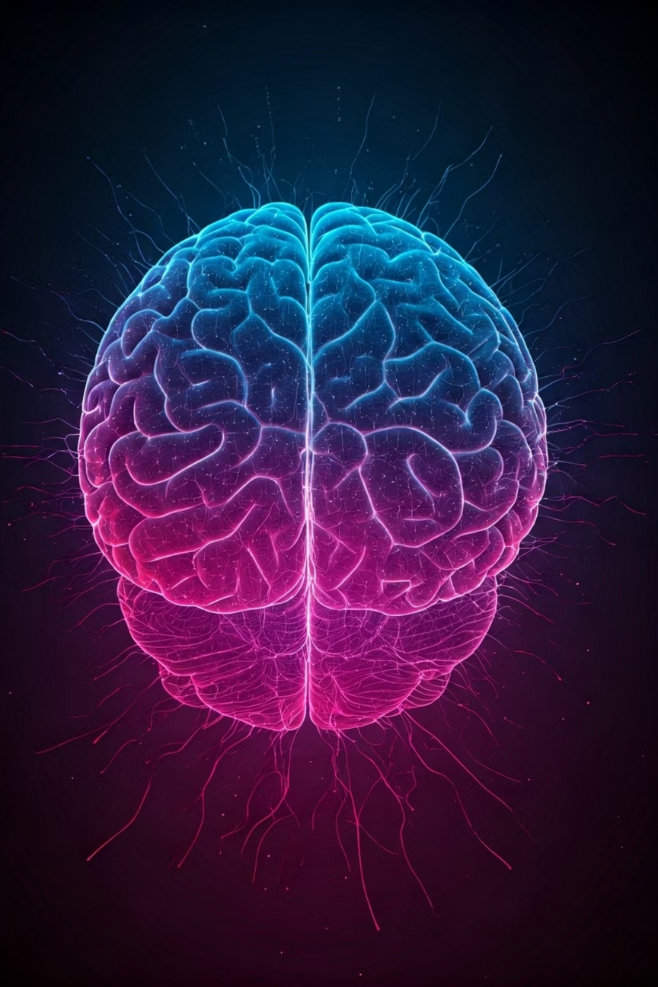
INTRODUCTION
THIS IS MY PROJECT ON CLASSIFYING WHETHER A TWEET WAS WRITTEN BY A HUMAN OR GENERATED BY AI, USING MACHINE LEARNING

Slide 4

Problem Statement
AI-GENERATED TWEETS ARE INCREASING.
FAKE ACCOUNTS SPREAD MISINFORMATION.
GOAL: BUILD A MODEL TO DETECT HUMAN VS AI TWEETS.
Nowadays, AI models like GPT can write tweets, and bots spread fake information. Our goal is to build a system that can check if a tweet is from a human or an AI.

Slide 5
Existing System
Existing System
Existing System
EX : TURNITIN AI DETECTION
BUILT INTO PLAGIARISM CHECKER TURNITIN.
TARGETS ESSAYS AND ACADEMIC WRITING.
SHOWS % PROBABILITY OF AI-GENERATED CONTENT
IT IS A MODEL WHICH DETECTS ESSAY IS MADE OF AI OR HUMAN
EX : TURNITIN AI DETECTION
BUILT INTO PLAGIARISM CHECKER TURNITIN.
TARGETS ESSAYS AND ACADEMIC WRITING.
SHOWS % PROBABILITY OF AI-GENERATED CONTENT
IT IS A MODEL WHICH DETECTS ESSAY IS MADE OF AI OR HUMAN
Link : https://www.google.com/aclk?sa=L&ai=DChsSEwinj_eWldWPAxWVpGYCHXv2AYsYACICCAEQAhoCc20&co=1&ase=2&gclid=Cj0KCQjwrJTGBhCbARIsANFBfgtaTt09QGDbNTlGA_3hE1JeujySjImbshUvWBO1mqM76TGGjM9H5VQaAlhkEALw_wcB&ei=hBbFaIeeL4_G4-EPif3p-Qs&cid=CAASJeRo8HXjClgiYRmUC5MGIfW9dDv4IfSF8aWpy7mAF03CCaTovr8&cce=2&category=acrcp_v1_32&sig=AOD64_3JvtpzIulEc9zu0eeS5sbrf5K2BQ&q&sqi=2&nis=4&adurl&ved=2ahUKEwiH8O2WldWPAxUP4zgGHYl-Or8Q0Qx6BAgYEAE
EX : TURNITIN AI DETECTION
BUILT INTO PLAGIARISM CHECKER TURNITIN.
TARGETS ESSAYS AND ACADEMIC WRITING.
SHOWS % PROBABILITY OF AI-GENERATED CONTENT
IT IS A MODEL WHICH DETECTS ESSAY IS MADE OF AI OR HUMAN

Slide 6
Proposal System
Input: Tweet text (+ account info).
Processing: TF-IDF → Logistic Regression.
Output: Predicts Human or Bot.
Special Feature: Feedback loop → adds correction → retrains → model keeps improving.

Slide 7
Objectives
The objective of this project is to create a system that can tell if a tweet was written by a human or a bot, using machine learning. The system should be easy to use, give quick predictions, and learn from its mistakes through user feedback to keep improving over time.

Slide 8
Pipeline / Methodology
Load dataset
Preprocess text + encode account.type
TF-IDF Vectorization
Combine features
Train Logistic Regression model
Evaluate results
This was our pipeline: start with data, preprocess it, apply TF-IDF, combine features, train the Logistic Regression model, and then evaluate the performance.

Slide 9
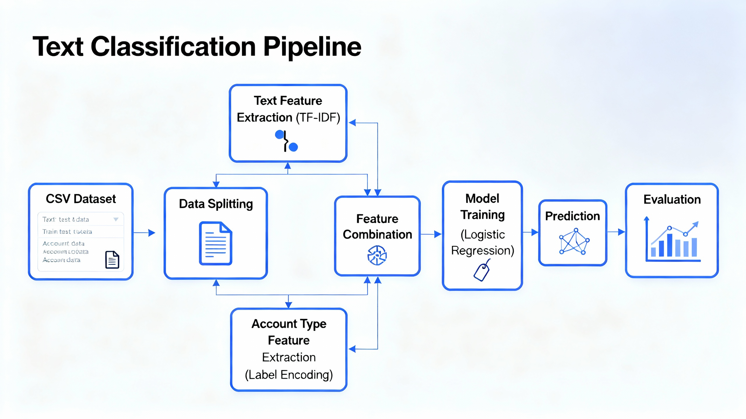

Slide 10

Dataset
Dataset : TweepFake (Kaggle).
Important columns :
• text → the tweet itself
• class_type → (Human, GPT2, RNN, etc.)
• account.type → target Human / Bot
Features : text
Label : account.type
We used a dataset called TweepFake from Kaggle. It contains tweets, info about the account type, and whether the tweet was human or AI-generated. Our input was the tweet text and account type, and the output label was the class type.

Slide 11
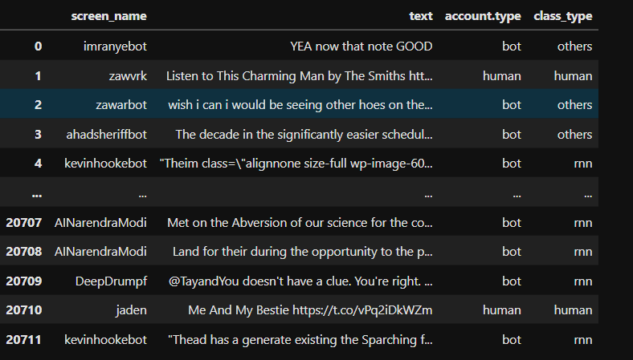

Slide 12

Preprocessing
Removed unnecessary columns.
Converted account.type into numbers (Human=0, Bot=1).
Used TF-IDF to convert text into numbers (max 5000 words, bigrams).
Combined text features with account type.
Since machine learning can’t work with raw text, we had to process it. We cleaned the data, converted account type into numbers, and applied TF-IDF — which basically turns text into numeric features. Then we combined text and account info together.

Slide 13
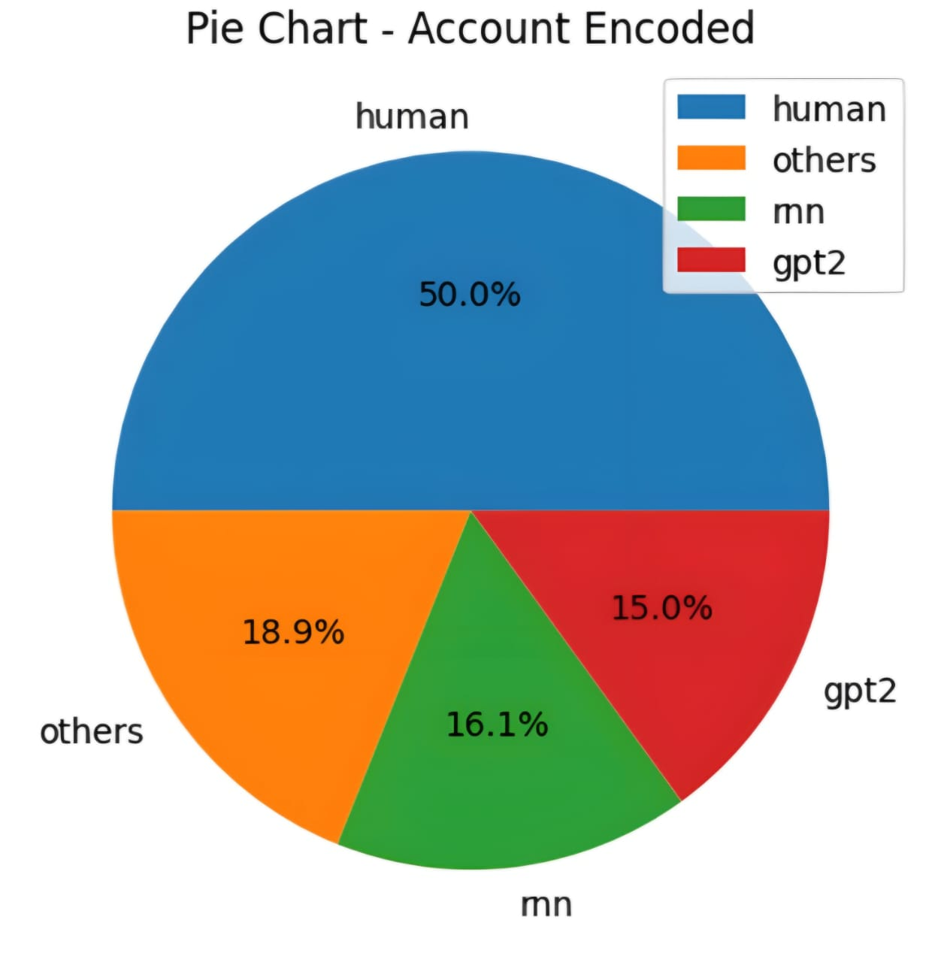
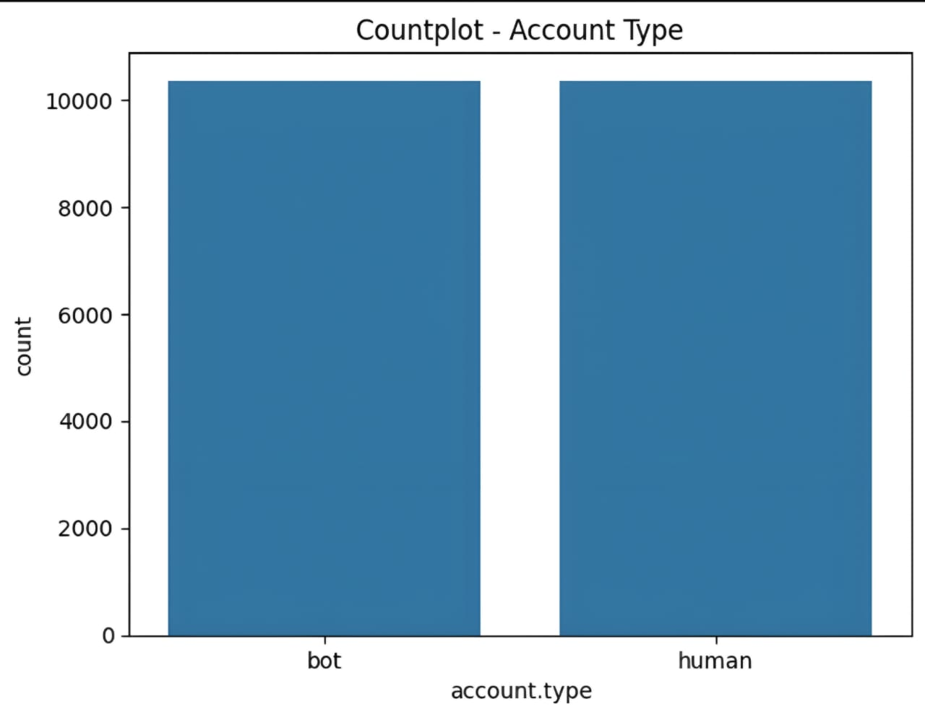
GRAPHS

Slide 14
Model
Model: Logistic Regression
Good for classification problems
Finds the best boundary between categories
Max Iterations: 300 (enough time to learn)
We used Logistic Regression because it’s simple and effective for classification. It finds the best boundary between Human and AI tweets. We gave it up to 300 steps to train properly, and used the lbfgs solver, which is efficient for big data and multiclass classification.

Slide 15
Results
Accuracy: ~76%
Confusion Matrix → shows correct vs wrong predictions
Classification Report → precision, recall, F1-score
Our model reached around 76% accuracy, which is very good. The confusion matrix shows where predictions went right or wrong. The classification report gives deeper metrics like precision and recall.

Slide 16
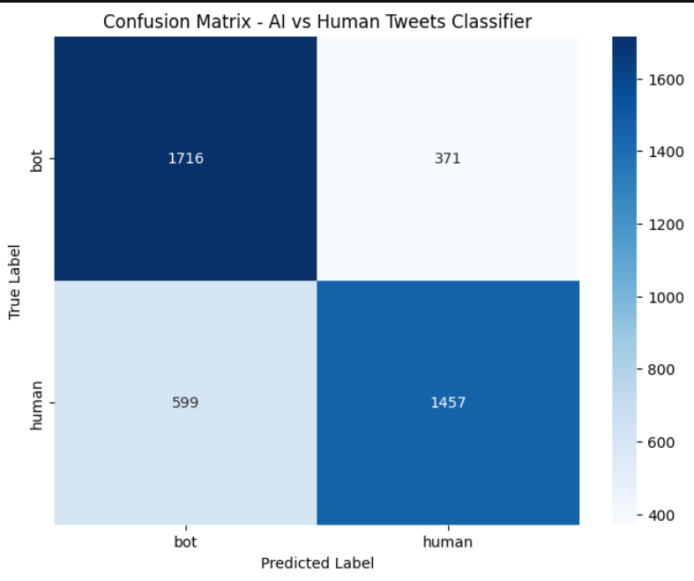
Confusion Matrix Heatmap

Slide 17
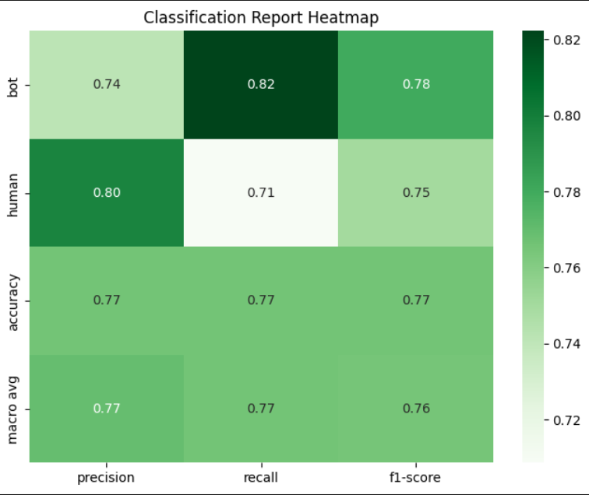
Report Heatmap

Slide 18
Pros & Cons
✅ Pros (Advantages)
Simple & Efficient → Uses Logistic Regression with TF-IDF (easy to train and explain).
High Accuracy → Reaches ~76% .
Practical Use Case → Helps in detecting bots, spam, or misinformation on social media.
Extendable → Can add more AI models (GPT, RNN, Others) or advanced algorithms later.
Feedback Loop → Model can learn from mistakes and improve over time.
❌ Cons (Limitations)
Short Text Challenge → Tweets are small, so sometimes hard to differentiate AI vs human.
Not Foolproof → Advanced AI-generated text (e.g., GPT-4, LLaMA) might bypass detection.

Slide 19
🌍 Applications of Human vs Bot Tweet Classifier
Social Media Moderation
Cybersecurity
Journalism & Fact-Checking
Brand & Marketing Analytics

Slide 20
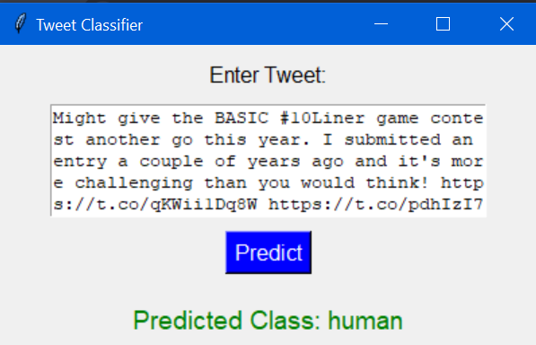
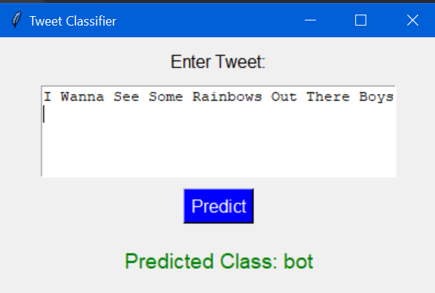
User Interface
User enters tweet.
Model predicts Human or Bot.
If wrong → user provides correct label.
System saves correction & retrains model.

Slide 21
Conclusion
Built a system to detect Human vs Bot accounts using tweet text.
Logistic Regression gave strong accuracy (~76%).
Web app with feedback → makes model self-learning.
Helps fight misinformation and bot detection on social media.

Slide 22


THANK YOU

